Slide 1
Informed Search: A* Algorithm

Slide 2
A* Search
A* search is the most commonly known form of best-first search.
It uses heuristic function h(n), and cost to reach the node n from the start state g(n). It has combined features of UCS and greedy best-first search, by which it solves the problem efficiently.
Using the heuristic function, a* search algorithm finds the shortest path through the search space.
This search algorithm expands the search tree and provides optimal results faster.
A* algorithm is similar to UCS except that it uses g(n)+h(n) instead of g(n).

Slide 3
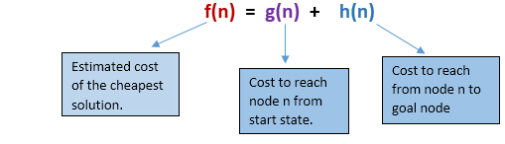
In A* search algorithm, we use search heuristic as well as the cost to reach the node. Hence we can combine both costs as following, and this sum is called as a fitness number.

Slide 4
A* Search algorithm:
Step1: Place the starting node in the OPEN list.
Step 2: Check if the OPEN list is empty or not, if the list is empty then return failure and stops.
Step 3: Select the node from the OPEN list which has the smallest value of evaluation function (g+h), if node n is goal node then return success and stop, otherwise
Step 4: Expand node n and generate all of its successors, and put n into the closed list. For each successor n', check whether n' is already in the OPEN or CLOSED list, if not then compute evaluation function for n' and place into Open list.
Step 5: Else if node n' is already in OPEN and CLOSED, then it should be attached to the back pointer which reflects the lowest g(n') value.
Step 6: Return to Step 2.

Slide 5
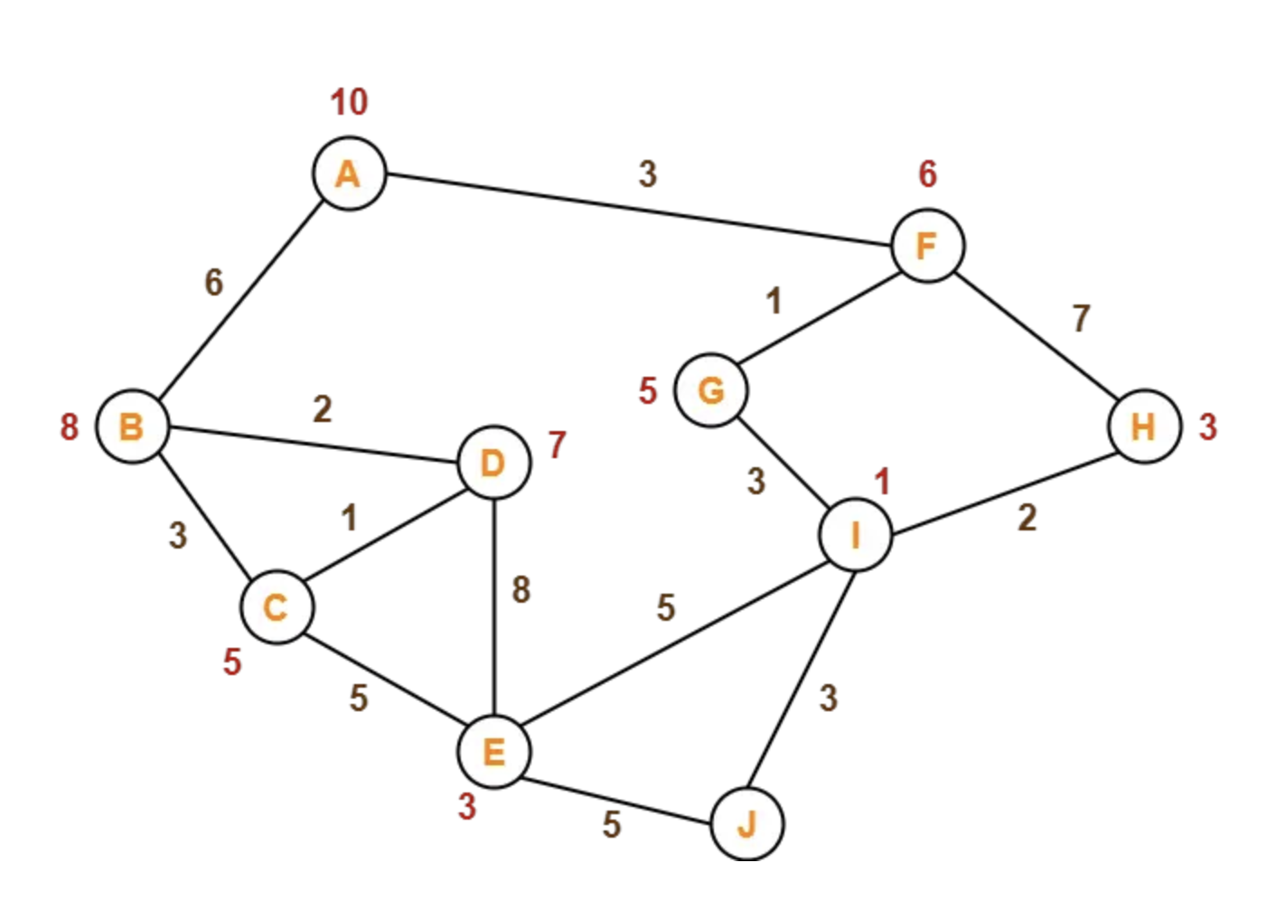
Example-1

Slide 6

Example-1
A | B | C | D | E
10 | 8 | 5 | 7 | 3
F | G | H | I | J
6 | 5 | 3 | 1 | -

Slide 7
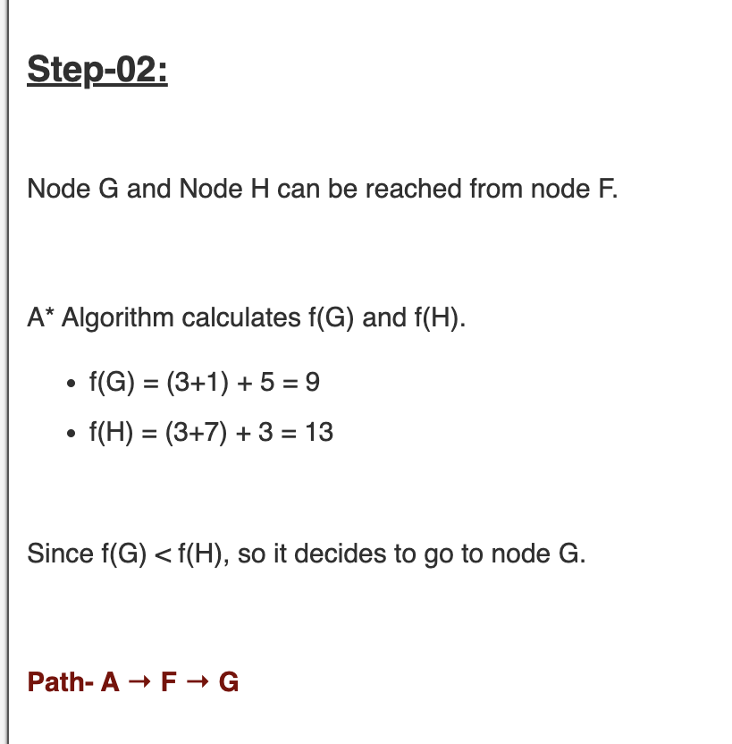
Example-1
A | B | C | D | E
10 | 8 | 5 | 7 | 3
F | G | H | I | J
6 | 5 | 3 | 1 | -

Slide 8

Example-1
A | B | C | D | E
10 | 8 | 5 | 7 | 3
F | G | H | I | J
6 | 5 | 3 | 1 | -

Slide 9

Example-1
A | B | C | D | E
10 | 8 | 5 | 7 | 3
F | G | H | I | J
6 | 5 | 3 | 1 | -

Slide 10
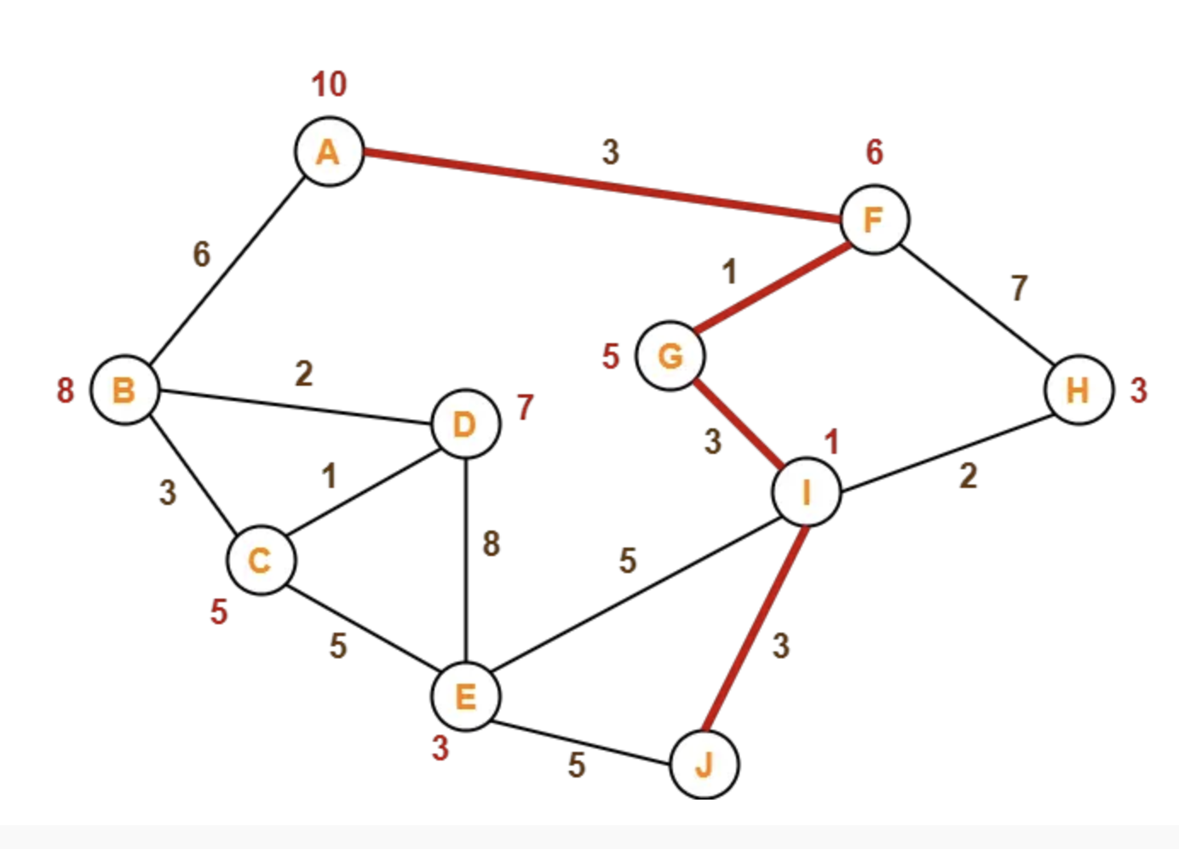
Example-1

Slide 11
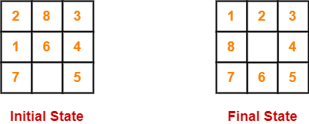
Example-2

Slide 12
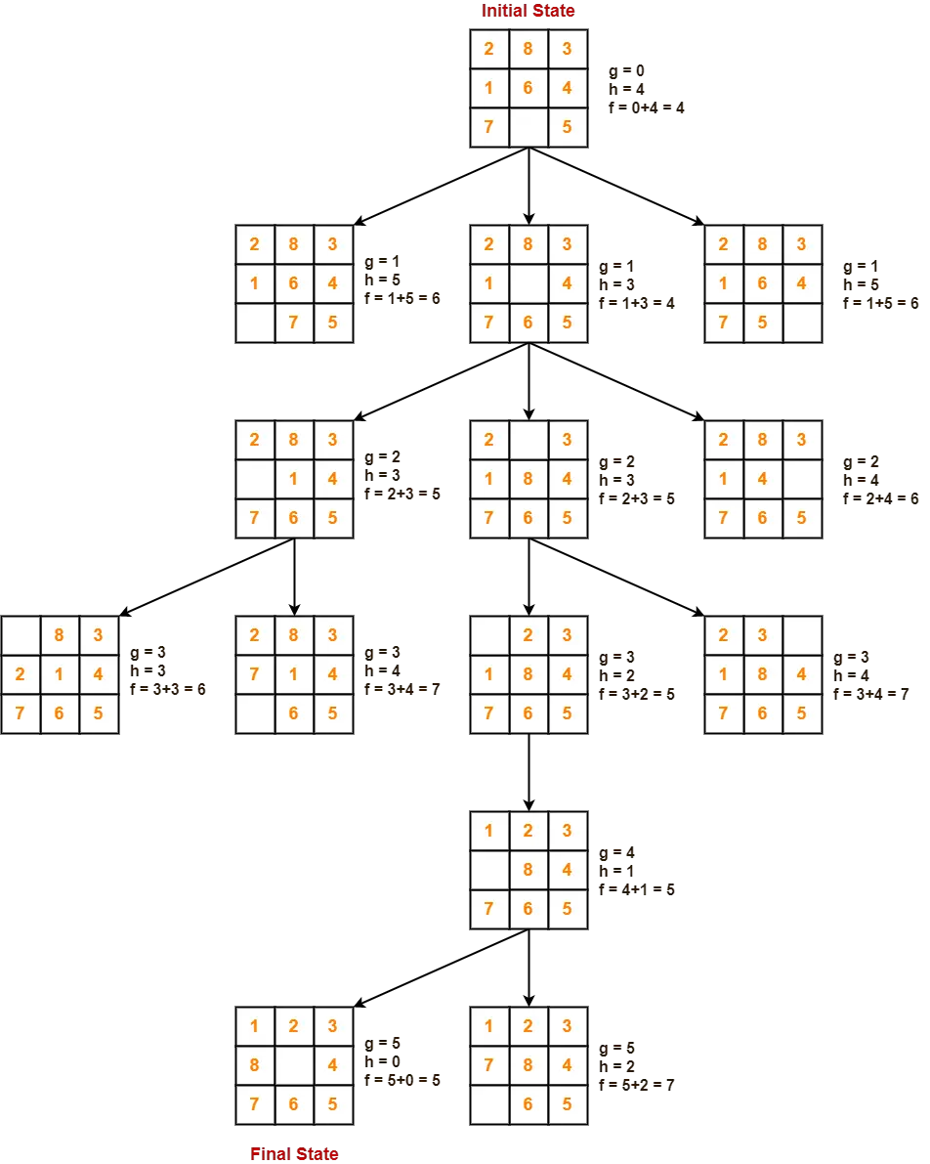

Slide 13
Advantages:
A* search algorithm is the best algorithm than other search algorithms.
A* search algorithm is optimal and complete.
This algorithm can solve very complex problems.
Disadvantages:
It does not always produce the shortest path as it is mostly based on heuristics and approximation.
A* search algorithm has some complexity issues.
The main drawback of A* is the memory requirement as it keeps all generated nodes in the memory, so it is not practical for various large-scale problems.

Slide 14
Complexity
Time Complexity: The time complexity of A* search algorithm depends on heuristic function, and the number of nodes expanded is exponential to the depth of solution d. So the time complexity is O(b^d), where b is the branching factor.
Space Complexity: The space complexity of A* search algorithm is O(b^d)

Slide 15
Performance measure
Complete: A* algorithm is complete as long as:
Branching factor is finite.
Cost at every action is fixed.
Optimal: A* search algorithm is optimal if it follows below two conditions:
Admissible: the first condition requires for optimality is that h(n) should be an admissible heuristic for A* tree search. An admissible heuristic is optimistic in nature.
Consistency: Second required condition is consistency for only A* graph-search.

